Slide 1
REDCap and R
Stephan Kadauke MD PhD

Slide 2
Goal: Learn how to download and process REDCap data using R
Objectives:
Download data from a REDCap database into R using REDCapR or REDCapTidieR
Drill down into the REDCapTidieR supertibble using the RStudio Data Viewer
Use REDCapTidieR utility functions to extract individual data tibbles, apply labels, and export to Excel

Slide 3

What is REDCap?
Database solution for research and operations
Secure and accessible from a web browser
Can collect “any type of data in any environment”
Probably installed at your institution, you can probably use it for free, and you can probably even store PHI
https://www.project-redcap.org

Slide 4

What is REDCapR?
An R package for interacting with REDCap
A set of functions that wrap the REDCap API
redcap_read()
redcap_metadata_read()
redcap_write()
Well engineered, tested, and maintained
https://ouhscbbmc.github.io/REDCapR

Slide 5


The REDCART database
Dataset on patients treated with CAR-T cells for B-ALL
Longitudinal – CRFs organized by events
Contains repeated CRFs

Slide 6

Your Turn
Open the file named 04 – REDCap and R.qmd In the exercises folder.
Read what it says and follow the instructions to complete the exercise.

Slide 7
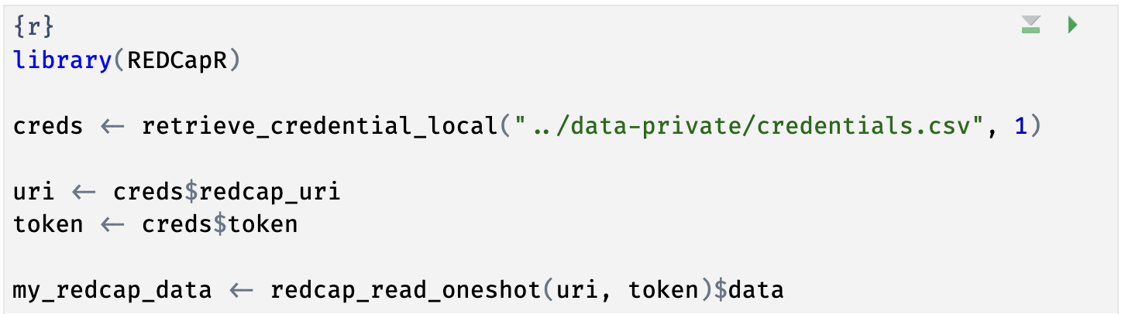
Notes:
Here’s the code chunk you just ran. This code looked up credentials to a REDCap project in a local file, and then downloaded the data from that REDCap project via the REDCap API, facilitated by the REDCapR package. If you haven’t looked at R code before, this will look very strange. In the next few slides I’m going to demystify this code.

Slide 8



retrieve_credential_local()
creds <- retrieve_credential_local(file_name, pid)
csv
file_name.csv
REDCap PID
Notes:
Let’s look at the next line of code in that chunk. It reads, …
There is a lot of R going on in this line of code. What is does is that first calls a function named retrieve_credential_local(). This function is part of the REDCapR package. It looks at a special CSV file with REDCap credentials, such as an API token and project IDs, and this function returns some information with these REDCap credentials. This information is then stored as an object named creds in R’s memory.
Why do we use that function for this? Because this way we don’t have to hardcode credentials into our R code, which is considered bad practice. So REDCapR makes it easy for you to do the right thing!

Slide 9
object
(stores output)
function
(does stuff)
arguments
(inputs)
creds <- retrieve_credential_local(file_name, pid)
assignment operator
(“gets”)
Notes:
Let’s look a little bit closer at what happens here. First, we have retrieve_credential_local, which is a function. Functions are super important in R.
Functions take zero, one, or more inputs, and they return one output.
** The inputs are called arguments and go into parentheses. If there’s more than one argument, they get separated with commas.
** You can capture the output in an object,
** using the assignment operator. This is a smaller than sign followed by a minus or dash and is supposed to look like an arrow pointing left. In other languages this assignment operator is a single equals sign, and one of the quirks of R is that they use this arrow looking sort of assignment operator instead. People pronounce this operator as “gets” … as in creds ”gets” retrieve_credential_local “of” filename and pid.

Slide 10
uri <- creds$redcap_uri
list
creds
redcap_uri | "https://redcap.chop.edu/api/"
username | "myusername"
project_id | 1
token | "37BCFC38D45F10C47EAF4D8B97BFC32F"
comment | CAR-T cell trials
uri
"https://redcap.chop.edu/api/"
Notes:
Let’s look at the next line. This says, uri <- creds $ redcap_uri
The creds object which we just made in the previous command is a *list*. A list is an object that contains other objects. In this case, “creds” contains the following elements: redcap_uri, username, project_id, token, and comment.
The $ operator extracts an element from a list. In this case we’re extracting the redcap_uri element and then we’re storing it as an object named ‘uri’.

Slide 11
dollar operator
extracts an element from a list
uri <- creds$redcap_uri
list
a type of object that can contain
multiple arbitrary objects
Notes:
…

Slide 12
Your Turn
Write the R code to extract the element named token from the creds object and store it in a new object named token.

Slide 13
Don’t hardcode credentials!
- Explain the code chunk we just did

Slide 14
The Problem with Complex REDCap Databases

Slide 15
Why REDCapTidieR?
Make it easy to import REDCap projects into R
Even if they are complex: longitudinal, repeated events or instruments, surveys, and/or data access groups (DAGs)
Pulls data and metadata into a single object that can be easily explored in RStudio IDE
Make it robust and performant
Built on top of REDCap
Follows tidyverse software development lifecycle recommendations
97% test coverage
Extensive error checking with helpful error messages
Profiled to use base R where we found bottlenecks
Support labels (using {labelled}) and summary stats (using {skimr})
Make it easy to export a collaborator-friendly Excel file
Notes:
We’ve tried hard to come up with a lot of different edge cases and find ways to make things “just work”.
Semantic versioning, try our hardest to make breaking changes only with major version bumps – meant to make it possible to use REDCapTidieR in production-grade applications
Continuous integration on open-source GitHub repo

